Slide 1
Al-Farabi Kazakh National University
Higher School of Medicine
Aldehydes and ketones

Slide 2
INSTRUCTORS
Gulnaz Seitimova, PhD, Chemistry
Bates Kudaibergenova, PhD, Chemistry
Dias Tastanbekov, MSc, Chemistry

Slide 3
LEARNING OUTCOMES
As a result of the lesson you will be able to:
Topics
- The Carbonyl Group, Naming Simple Aldehydes and Ketones
- Properties of Aldehydes and Ketones
- Some Common Aldehydes and Ketones
- Oxidation of Aldehydes
- Reduction of Aldehydes and Ketones
- Addition of Alcohols: Hemiacetals and Acetals
- identify a carbonyl group, its polarity and shape
- name and draw simple aldehydes and ketones given a structure or a name
- describe the polarity, hydrogen bonding, and water solubility of aldehydes and ketones
- identify the products of the reduction of aldehydes and ketones
- identify the differences between hemiacetals, hemiketals, acetals, and ketals
- predict the products of hemiacetal, hemiketal, acetal, and ketal formation and their hydrolysis

Slide 4
Literature
Organic Chemistry. International student version. 10ed. T.w.Graham Solomons, Craig. B. Fryhle., pp. 729-778

Slide 5
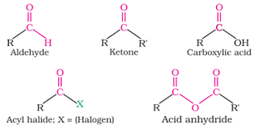
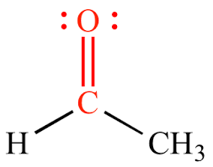
Topic - the Carbonyl Group
In organic chemistry, a carbonyl group is a functional group composed of a carbon atom double-bonded to an oxygen atom: C=O. It is common to several classes of organic compounds, as part of many larger functional groups. A compound containing a carbonyl group is often referred to as a carbonyl compound.

Slide 6
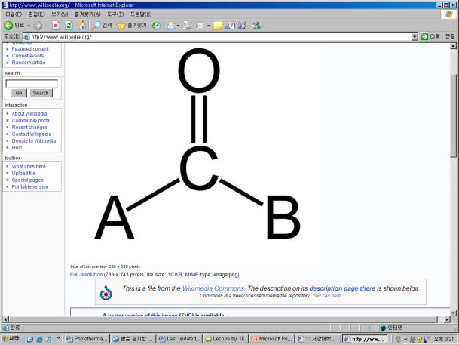
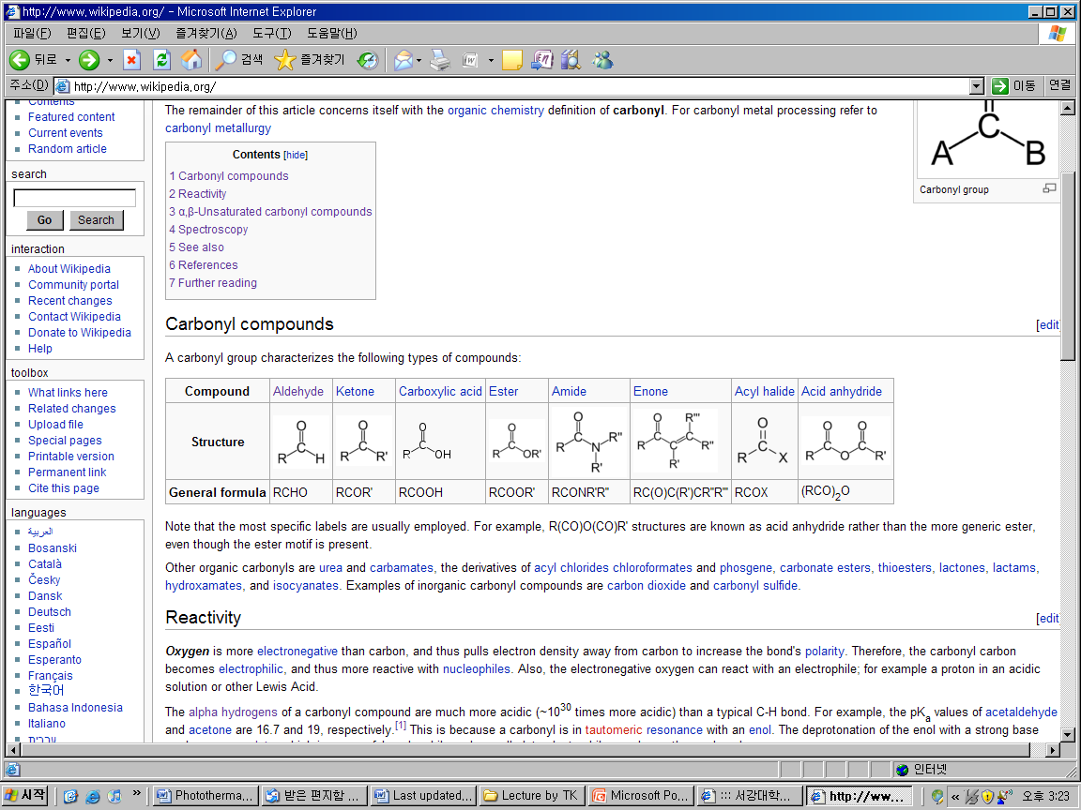
Carbonyl Group (I)
Carbonyl Compounds
The alpha hydrogens of a carbonyl compounds are much more acidic than a typical C-H bond.

Slide 7
Carbonyl Group (II)
Oxygen is more electronegative than carbon. Therefore, the carbonyl carbon becomes electrophilic, and thus more reactive with nucleophiles. The oxygen can react with an electrophile such as a proton and other Lewis acids

Slide 8
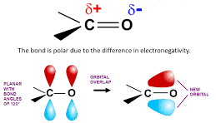
Carbonyl Group - polarity and shape
The bond is polar due to the difference in electronegativity.
Planar with bond angle 120º
Orbital overlap
new orbital

Slide 9
Properties of Aldehydes and Ketones
Aldehydes and Ketones have higher boiling points than hydrocarbons, but have lower boiling points than alcohols, because they have no H attached to the O.
Aldehydes and Ketones have strong odors, and are often used as flavorings or scents.
Small aldehydes are reasonably soluble in water. Large aldehydes are less polar and dissolve more readily in nonpolar organic solvents
The C1 and C2 aldehydes are gases at room temperature.
The C3 through C11 straight-chain saturated aldehydes are liquids, and the higher aldehydes are solid

Slide 10
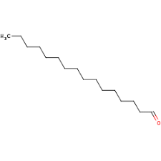
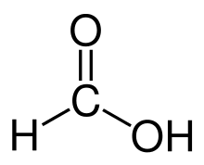
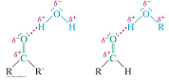
Describe the polarity, hydrogen bonding, and water solubility of aldehydes and ketones
long chain, so non-polar.
non-polar, so don’t soluble in water.
non-polar, so high solubility in non-polar solvents
short chain, so polar.
polar, so soluble in water.
polar, so low solubility in non-polar solvents
Good solvents for alcohols
Lone pair of electron on oxygen of carbonyl can accept a hydrogen bond from O⧿H or N⧿H
Acetone and acetaldehyde are miscible in water

Slide 11

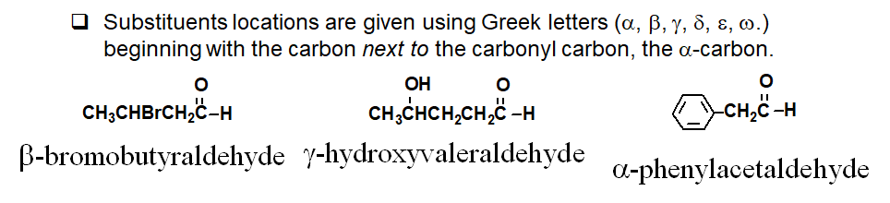
Nomenclature of Aldehydes
Acyclic aliphatic aldehydes are named as derivatives of the longest chain containing the aldehyde group by changing the suffix –e of the parent alkane to –al.
-CHO group is attached to a ring, the suffix –carbaldehyde may be used.
methanal
(formaldehyde)
ethanal
(acetaldehyde)
propanal
(propionaldehyde)
butanal
n-butyraldehyde

Slide 12
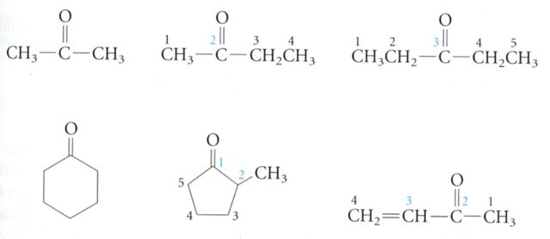
Nomenclature of Ketones
Ketones are named using IUPAC nomenclature by changing the suffix –e of the parent alkane to –one.
propanone
(acetone)
2-butanone
(ethyl methyl ketone)
3-pentanone
(diethyl ketone)
2-methyl cyclopentanone
3-buten-2-one
(methyl vinyl ketone)
cyclohexanone

Slide 13
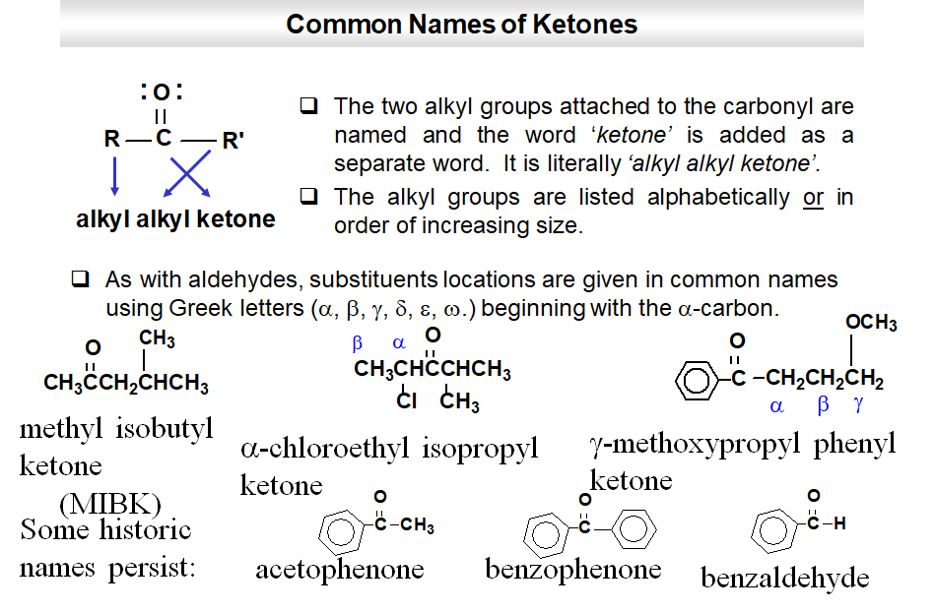

Slide 14
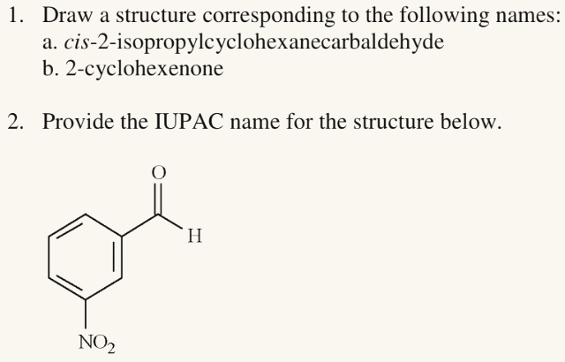
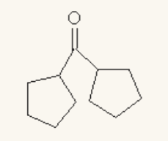
Name and draw simple aldehydes and ketones given a structure or a name

Slide 15
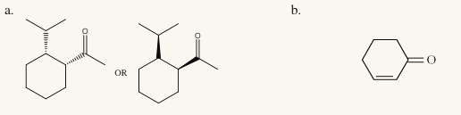
Name and draw simple aldehydes and ketones given a structure or a name
meta-nitro
benzaldehyde
dicyclopentyl
ketone

Slide 16
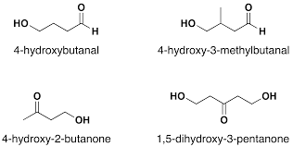
name and draw simple aldehydes and ketones given a structure or a name

Slide 17
name and draw simple aldehydes and ketones given a structure or a name

Slide 18

Synthesis of Aldehydes and Ketones
Aldehydes can be prepared by reacting a primary alcohol with an oxidizing agent (an chromium (VI) oxidizing agent)
Ketones can be created by oxidation of secondary alcohol
oxidizing
agent

Slide 19
Reactions of Aldehydes and Ketones
Let’s focus on the reactivity of the carbonyl group!!!
Nucleophilic Addition
  Ketones are less reactive than aldehydes
Reduction and Oxidation
Keto-Enol Tautomerism
The Aldol Condensation

Slide 20
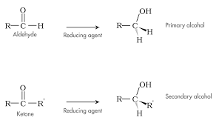
- Reduction of Aldehydes and Ketones
Primary alcohol
Aldehyde
Reducing agent
Secondary alcohol
Reducing agent
Keton

Slide 21
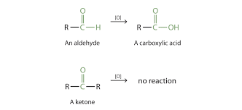
- Oxidation of Aldehydes
An aldehyde
A carboxylic acid
no reaction
A ketone

Slide 22
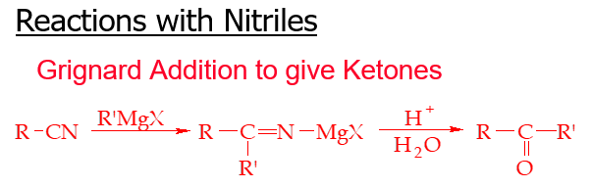
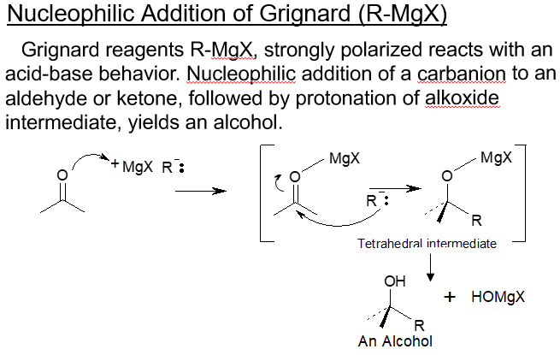

Slide 23
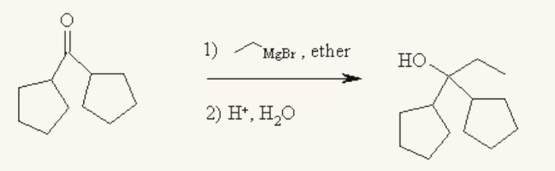
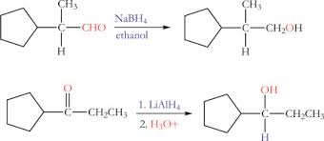
identify the products of the reduction of aldehydes and ketones

Slide 24
identify the products of the reduction of aldehydes and ketones
Notes:
MgOHBr H-OH

Slide 25
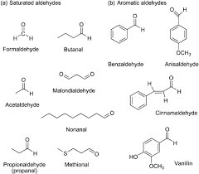
- Some Common Aldehydes and Ketones
Propionaldehyde
(propanal)
Formaldehyde
Butanal
Benzaldehyde
Anizaldehyde
Methional
Malondialdehyde
Acetaldehyde
Cynnamaldehyde
Nonanal
Vanilin

Slide 26
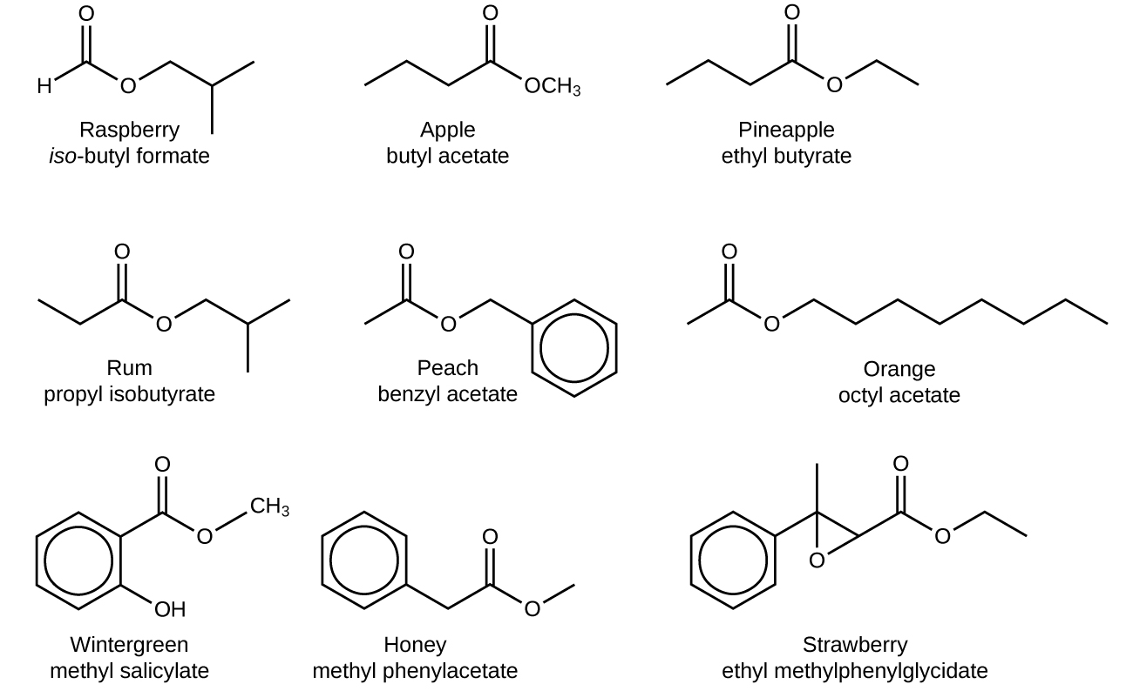
Common odors with carboxyl group

